Slide 1

Acids and Bases
Matthew P. Davey, MD
Oregon Health and Science University

Slide 2
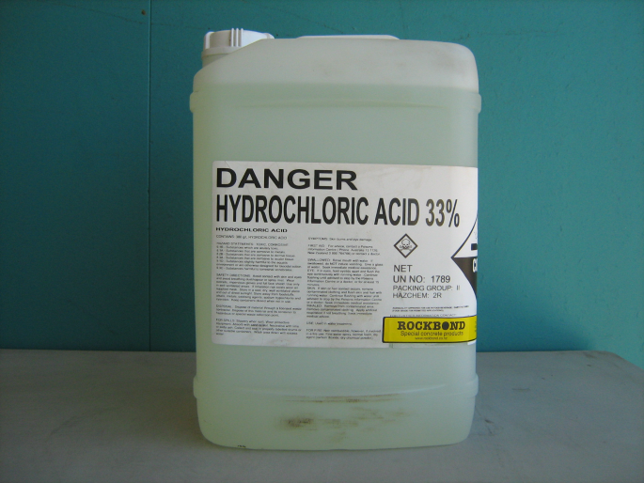
The General Principles
Acids: significant damage with pH<3
Alkalis: significant damage with pH>11
But extent of injury also depends on:
  Duration of contact
  Ability to penetrate tissues
  Volume
  Concentration

Slide 3
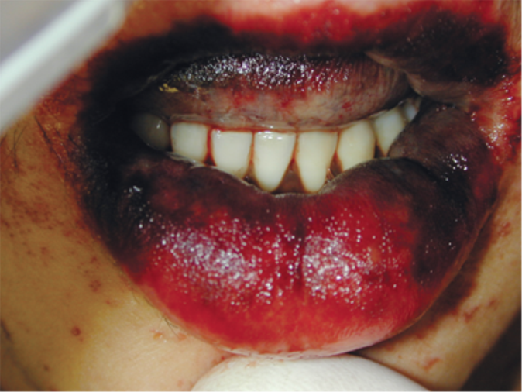
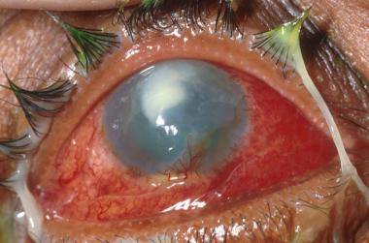
Alkalis
OH⁻ molecule able to penetrate deep into tissues
  Including cornea
Produce “liquefactive necrosis”
Injury within seconds
Notes:
Liquefactive necrosis produces protein dissolution, collagen destruction, fat saponification, cell membrane emulsification, transmural thombosis, and cell death.
Sodium hydroxide ingestion with significant lip burn, erythema, and swelling. And then sodium hydroxide splash injury to the eye.

Slide 4
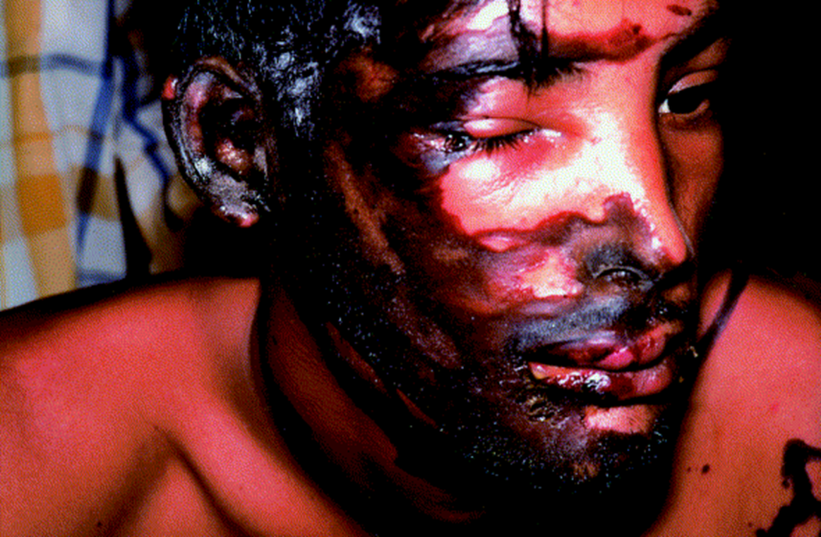
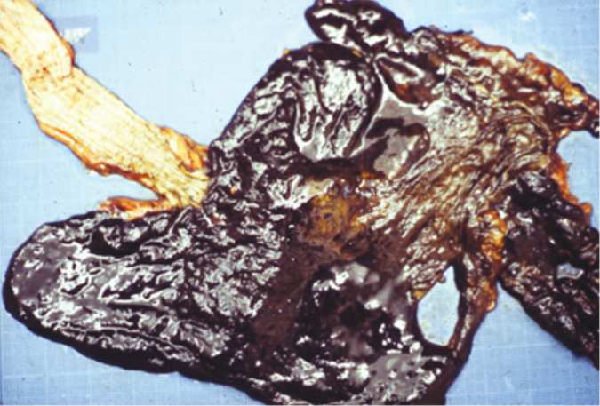
Acids
“coagulation necrosis”
Form eschar and necrosis
Limits deeper tissue penetration
  Including ocular

Slide 5

Chemical Burns: Etiology
>25,000 products (industrial, home, military, agricultural) can cause burns.
Burn Etiology
  50% Work-related
  25% From Assault
  20% to 30% Residential
Burn Mechanisms
  Desiccation, Corrosion, Oxidation-reduction Rx

Slide 6
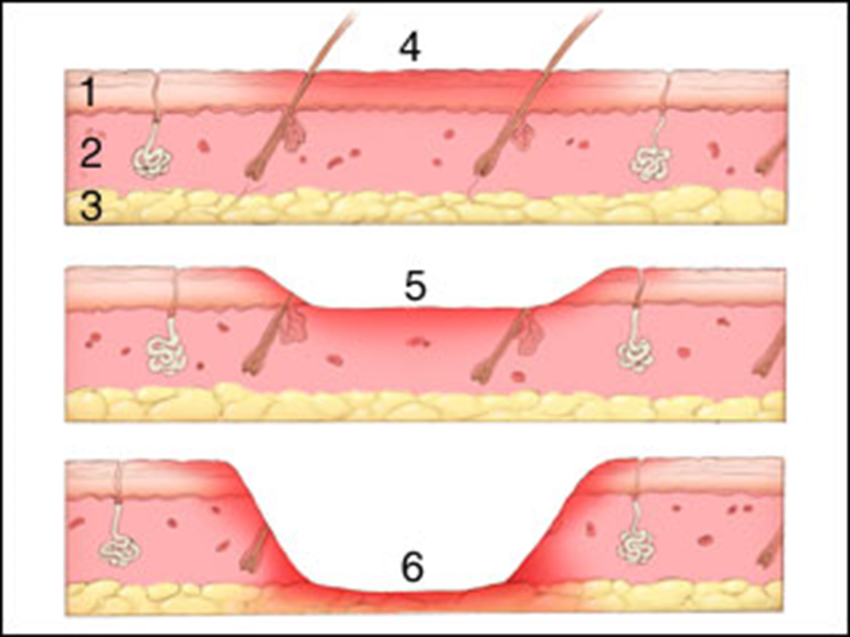
Chemical Burns: Grading
1st degree
2nd degree
3rd degree
Notes:
4th degree burns are down to fascia, muscle, and bone. Like 3rd degree burns, they have no pain associated with them.

Slide 7
Chemical Burn: Management
AIRWAY may require prophylactic intubation
DECON: Brush off dry chemicals, irrigate for at least 15-20 min & pH normalized
ANALGESICS
Topical Antibiotics (not systemic)
TETANUS: Booster ± Immunoglobulin

Slide 8
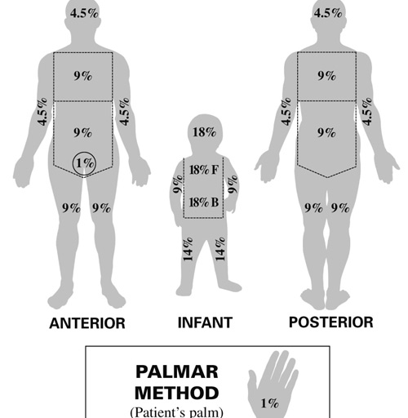
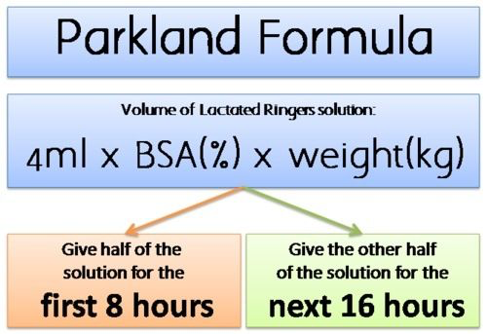
Management Continued…

Slide 9
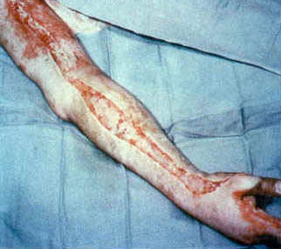
Management Continued…
Surgery:
  Escharotomy
    Circumferential burns
    Compartment Pressure > 35-40
  Debridement
  Grafting

Slide 10
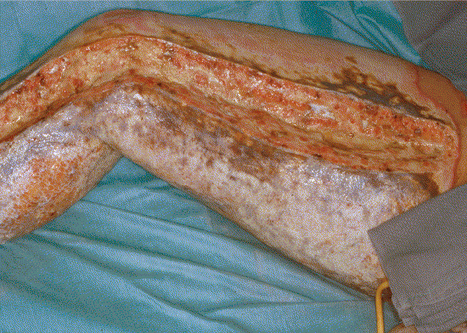
Some specific examples…

Slide 11

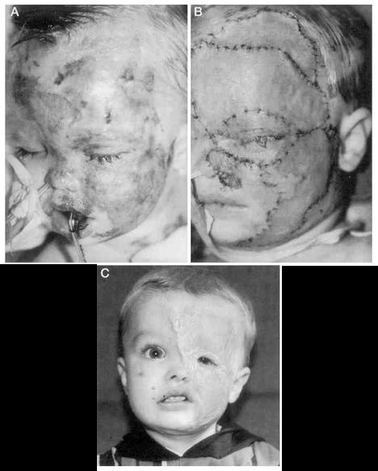
Sulfuric Acid Burns
“Vitriol Throwing” - Most common acid used for assault, widely available
Toilet bowl cleaners – 9%
Battery Acid 35%
Drain Cleaners 95-99% (“fuming sulfuric acid”)
Local burns
Dilute ASAP!!!

Slide 12
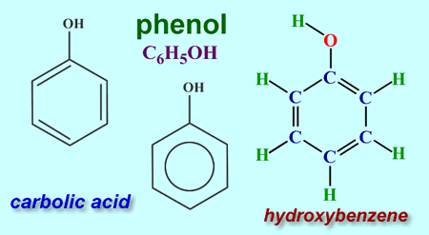
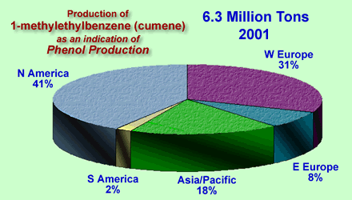
Phenol
Most phenol is made from methylethylbenzene (cumene)

Slide 13
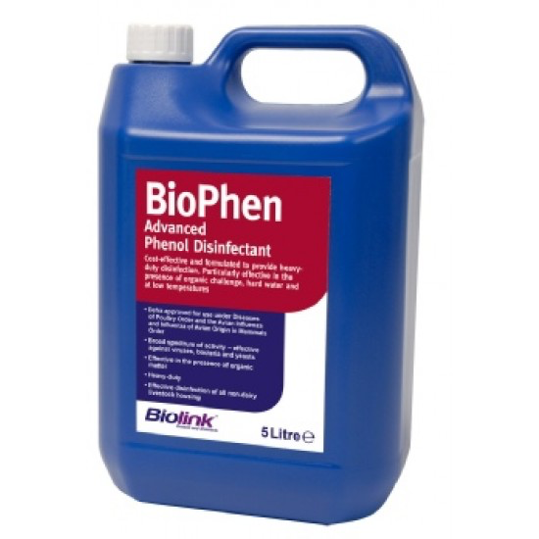
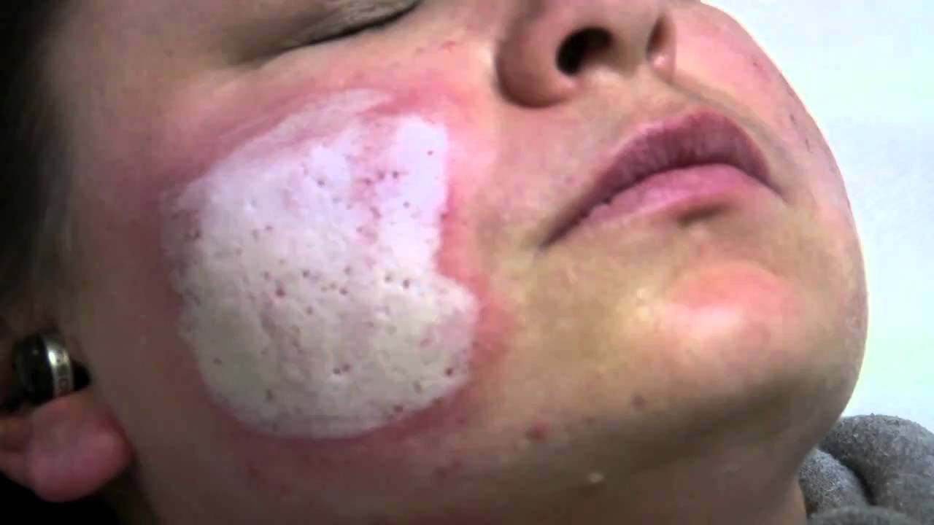
Phenol
Used in manufacture of resins, plastics, fertilizers & many others; as disinfectant and preservative
Also as a cosmetic chemical peel
PEG or isopropanol not water irrigation
Notes:
When phenol is mixed with water a bilayer with unique properties is created that makes it difficult to remove from tissues

Slide 14
Phenol
Readily absorbed via all routes
Local effects: skin burns
Systemic effects: agitation, lethargy, coma, GI irritation, pulmonary edema, methemoglobinemia, hemolysis, shock, dysrhythmias, seizures

Slide 15
Nitric Acid
Nitric acid is often produced alongside ammonia
Consumed locally in manufacture of fertilizer
Also used in production of explosives, munitions; and certain pigments, inks, dyes

Slide 16
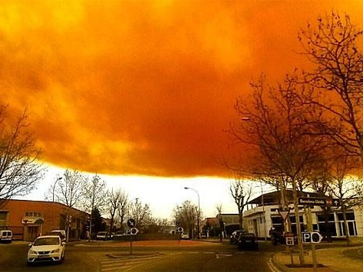
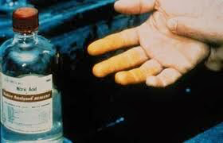
Nitric Acid Burns
Yellow or red fumes
Acrid, suffocating odor
Decomposes to oxides of nitrogen
Yellow to yellow-brown burns
Causes deep burns, pulmonary edema & oxides of nitrogen inhalation injury

Slide 17
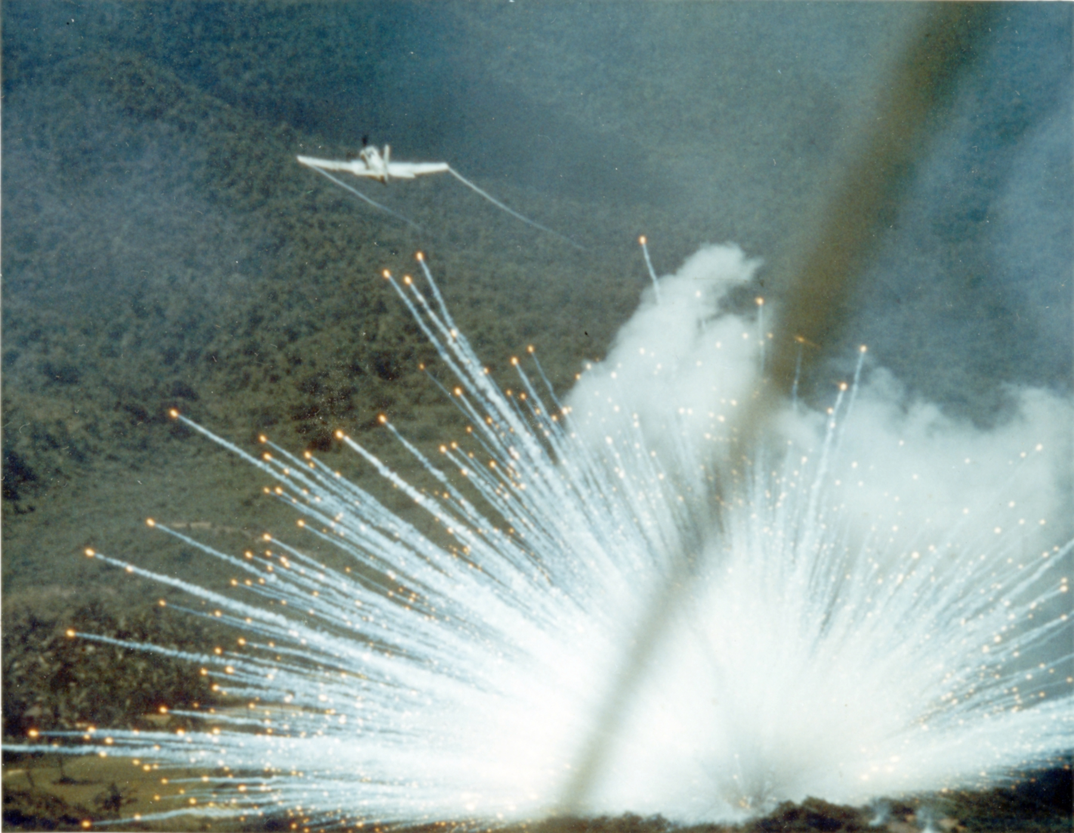
White (and Yellow) Phosphorus
Use in munitions (mortar rounds, grenades, bombs) and fireworks
Ignites spontaneously in air at 34C
  P + Air → P₂O₅ + Water → H₃PO₄
  Highly exothermic
Garlic, “musty sweet” odor
Luminescent properties
Notes:
Yellow phosphorus is white phosphorus with impurities in it. Highly exothermic reaction in combination with forming a strong acid leads to severe dermal burns.

Slide 18
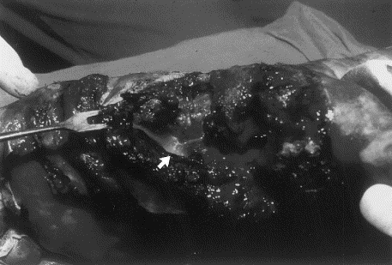
Smoking White Phosphorus Burn

Slide 19
White Phosphorus Burns
Severe pain, necrotic, yellowish, Chemical & Thermal Burns within seconds to minutes
Irrigation H₂0 (submerge), ? CuSO₄, UV Light Exam, Debride Imbedded P
↓Ca, ↓Mg, ↑PO₄ → ↑QTc Int, ↓QRS Voltage, Ventricular Dysrhythmias
Headache, delirium, psychosis, stupor, seizures, coma, hepatotoxic
Notes:
Copper sulfate has been used in the past as a temporizing measure. It temporarily neutralizes the outer surfaceof the phophorus. It also reacts with the phosphorus to form copper phosphide which is much more readily visualized for debridement. However, this has fallen out of favor because copper sulfate is also caustic and can cause hemolysis. The currently recognized approach to decontamination is via a wood’s lamp or in a darkened room looking for phophorescence. Incomplete decontamination is a common reason for delayed wound healing

Slide 20
Questions on Dermal Burns??

Slide 21
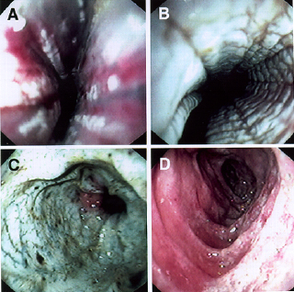
Injury Grading: Gastrointestinal Burns
Grade 2a
Grade 2b
Grade 3
Grade 1

Slide 22
Can we predict who has significant injury?
2 or more of vomiting, drooling, stridor, pain predicts significant esophageal injury
  These should receive endoscopy
Oropharyngeal burns are poorly predictive of esophageal injury

Slide 23
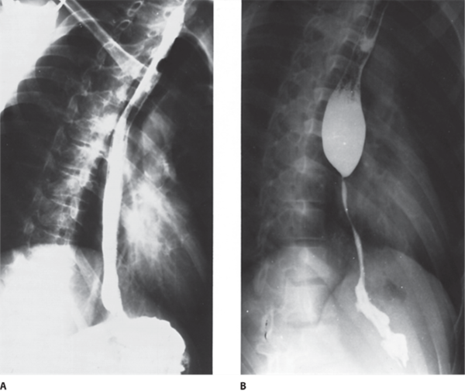
Long Term Sequelae of Caustic Ingestion
Esophageal scar forms stricture over weeks to months
Risk of stricture formation:
  Grade 1: 0%
  Grade 2: 75%
  Grade 3: 100%
Risk of latent esophageal carcinoma
  1000x higher than general population
Notes:
Picture A shows barium swallow several days after ingestion of lye. The esophageal is atonic, these is poor coating of the esophagus suggesting edema and intramural penetration. The picture in B shows several months later the significant stricture has developed.

Slide 24
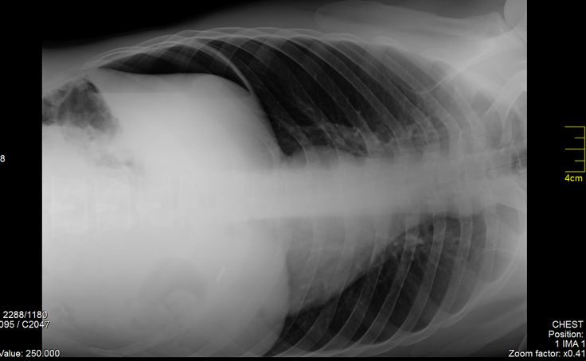
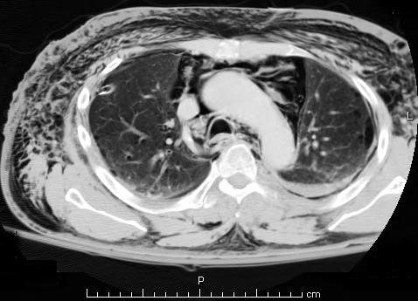
Diagnostic Testing
Elevated PT, PTT and pH<7.22 associated with severe injury
CXR, KUB looking for pleural effusion, pneumomediastinum or pneumoperitoneum (note: lacks sensitivity)
CT chest and abdomen much higher sensitivity to rule out perforation
??new role for CT chest to grade esophageal injury

Slide 25
Endoscopy
Should be preformed within 12 hours, not later than 24hours post ingestion
Wound strength is least between 5 and 14 days
Weaknesses:
  Unable to see serosal surface
  Unable to see past grade II or III lesion
Notes:
CT may be able to help where endoscopy falls off: seeing the depth of injury, seeing past a significant lesion that the endoscopist cannot go past.

Slide 26
Acute Management ABC’s
Airway and Breathing:
  Early intubation for stridor or respiratory distress
  Dexamethasone for airway edema
  Avoid neuromuscular blockerade
  Be prepared for surgical airway
Circulation
  Intravenous fluid boluses for “third-spacing” and hypotension

Slide 27
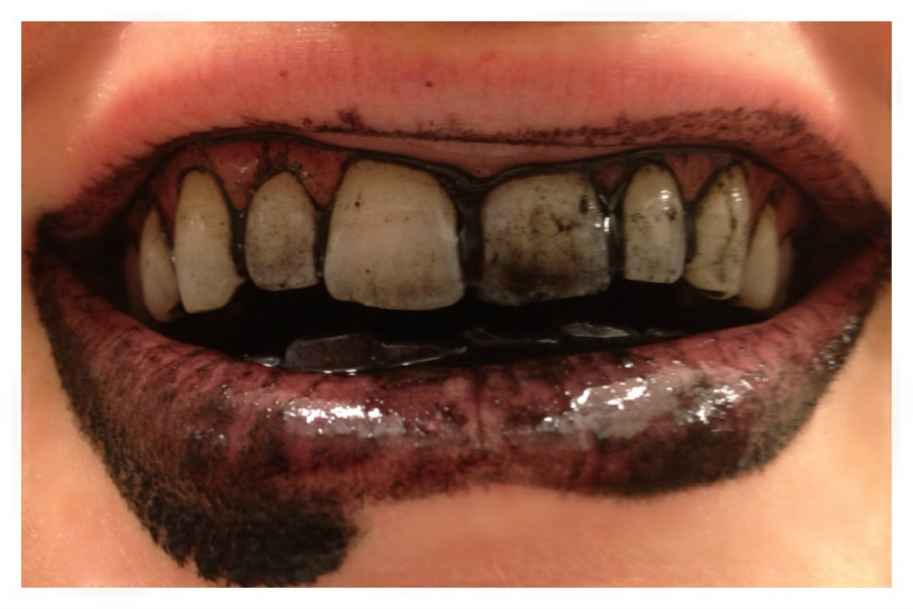
Decontamination
Remove all clothing
Brush powder/solid off skin
Copious irrigation of skin and eyes
Avoid inducing emesis
Avoid activated charcoal
Avoid neutralization
Can try dilution with milk or water in first few minutes

Slide 28
Surgery
Laparotomy or laporoscopy
Consider for:
  large ingestions (>150ml)
  persistent shock
  acidemia
  coagulopathy
NOTE: abdominal pain, tenderness may be missing even in severe acid ingestions

Slide 29
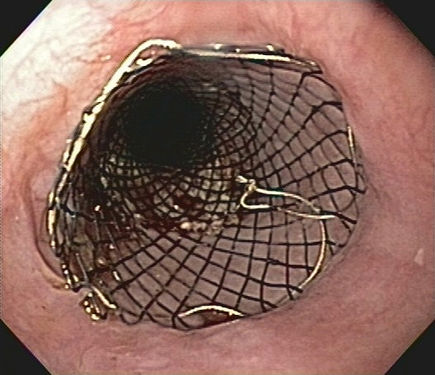
Subacute Management
Grade I injuries:
  advance diet as tolerated
Grade IIa:
  soft diet vs. NG tube
Grade IIb:
  possible benefit of corticosteroids
  intraluminal stent
Grade III:
  avoid corticosteroids
  intraluminal stent
Antibiotics reserved for identified infections

Slide 30
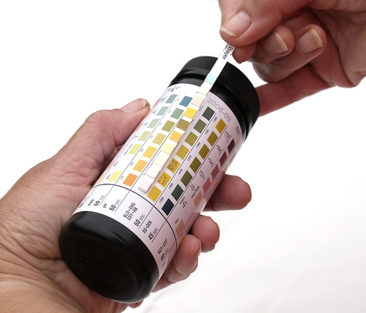
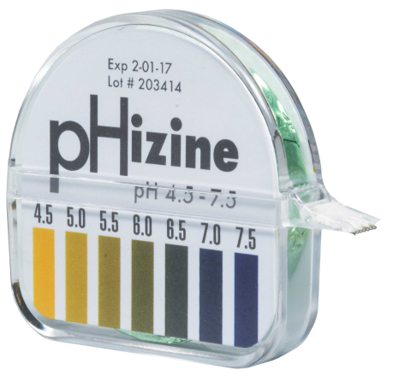
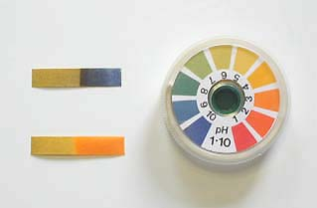
Management of Ocular Exposures
Splash injuries, malicious attacks, or from airbag rupture
Irrigate, irrigate, irrigate!
Goal to restore normal pH of 6.5 to 7.6
Can test with urine dipstick, litmus paper, or nitrazine paper
Ophthalmologist consult

Slide 31
A Case…
A small village of 500 fed only well water have a large outbreak (296 people) of:
  Nausea, vomiting, diarrhea
  Abdominal pain
  Paresthesias
All had consumed water from the same supply
NEJM. 1994;330(2):95-9

Slide 32
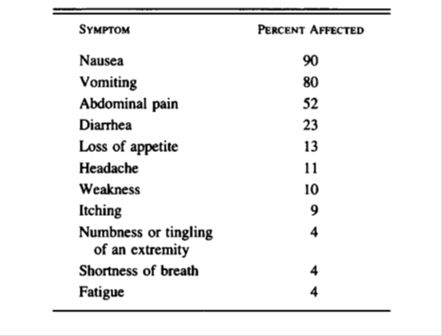
Case continued…
Water fluoride: 150mg/L (nl <1mg/L)
Outbreak resulted in:
  1 serious illness
    calcium 5.2mg/dl (nl 8.5-10.2)
    Fluoride 9.1mg/L (nl 0.01-0.03)
  1 death
    calcium 4.9mg/dl
NEJM. 1994;330(2):95-9

Slide 33
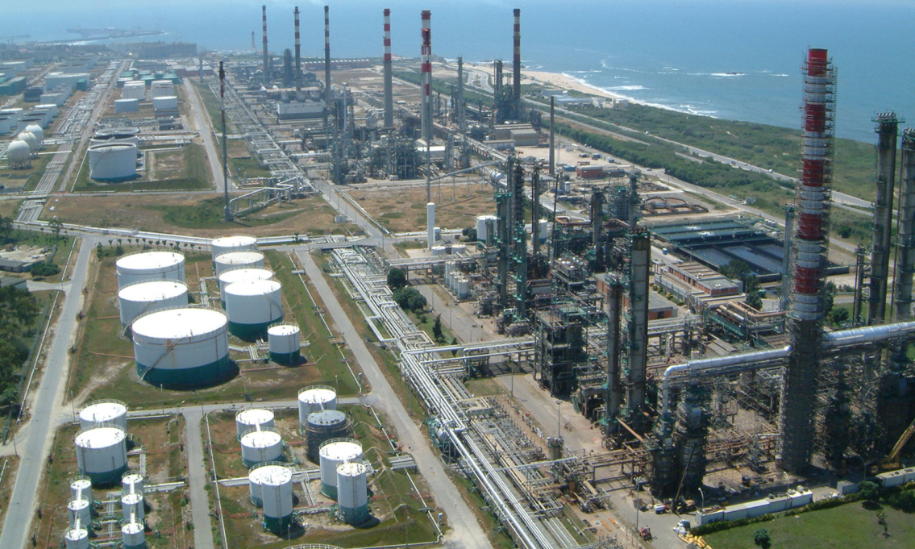
Another case
24,000kg of hydrofluoric acid released from petrochemical plant – spread to nearby community
939 seen in emergency room
ENT irritation, headache, dyspnea
43% with decreased
FEV1
17% hypoxemia
16% hypocalcemia
Notes:
We can discuss whether our management should change or other treatment modalities.

Slide 34
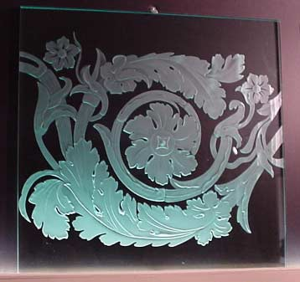
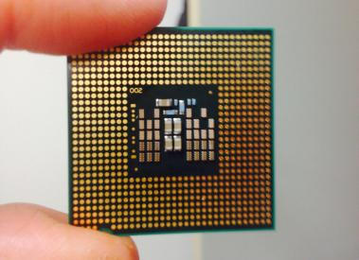
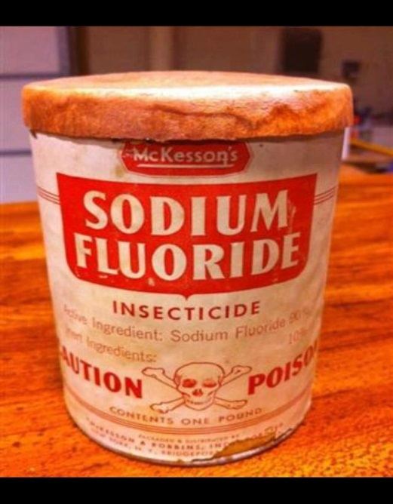
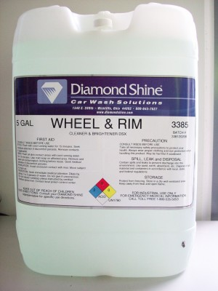
Hydrofluoric Acid – Where we find it
Notes:
The Nurenberg artist Schwanhard is given credit for the first attempt to use HF vapors to etch glass in 1670. Microchip etching. Wheel and rim cleaner. Historically used as an insecticide.

Slide 35
Why its different than other acids
Able to penetrate deeply into tissue and then dissociate into H⁺ and F⁻
F⁻ binds with extra- and intracellular calcium
  Neuroexcitation, vasospasm → neuropathic pain
  Hypocalcemia → dysrhythmias

Slide 36
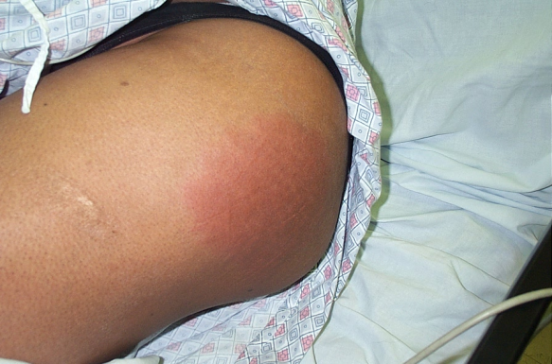
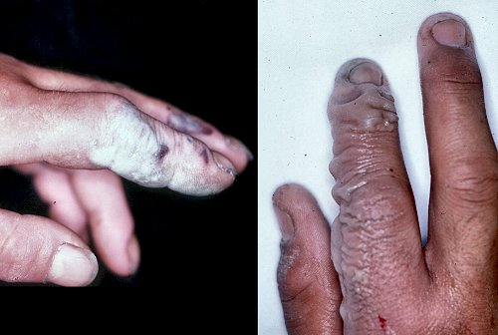
What we see clinically
Local effects – Skin
  Classic red (hyperemia), white (calcium complex precipitates) and blue (coagulative necrosis) sequence
  Toxicity dependent on body surface area (BSA), concentration, and contact time
    Immediate pain associated with high toxicity
    >2% BSA of high concentration associated with life-threatening systemic toxicity

Slide 37
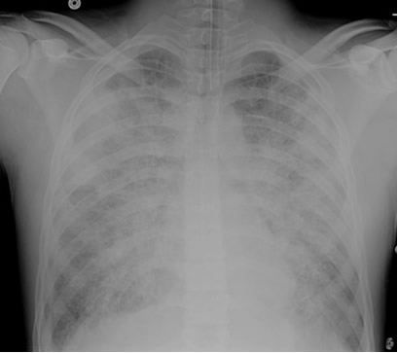
Local Toxicity
Pulmonary – inhalational exposure
  Upper tract – stridor
  Lower tract – wheezing, ARDS

Slide 38
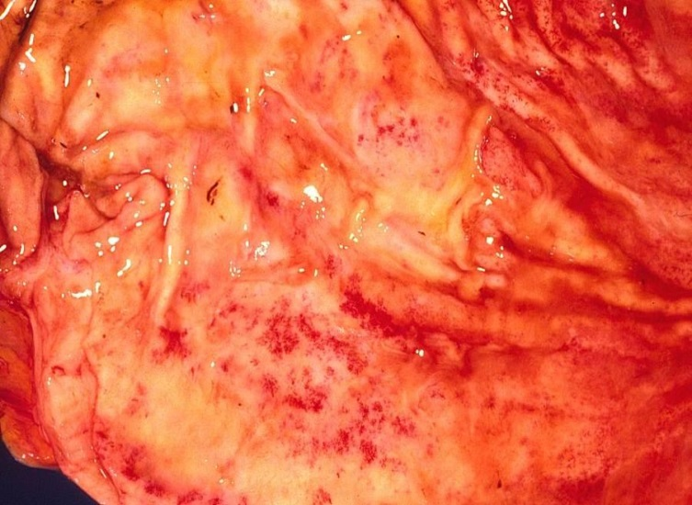
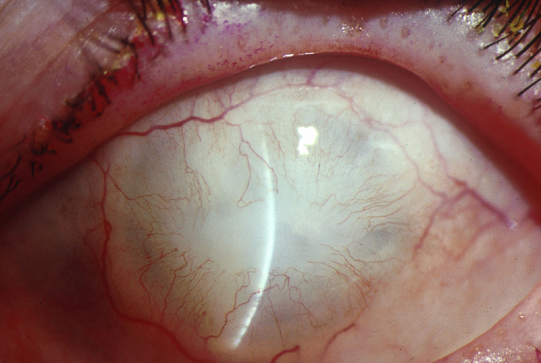
Local Toxicity
Gastrointestinal
Ocular
Nausea and vomiting
Gastritis, abdominal pain
Intentional ingestions almost universally fatal
Usually from gas, inhalational exposure
Also splashes
Corneal edema and ulcerations
Notes:
99% of the time, the acute gastritis is a moot point because ingestions are almost always universally fatal.

Slide 39
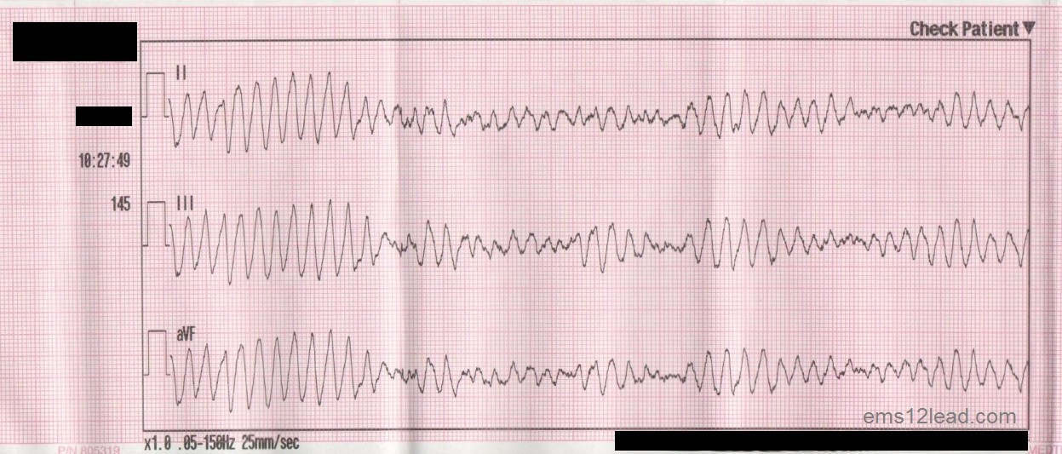
Systemic Toxicity
Hypocalcemia, hypomagnesemia → ventricular dysrhythmias
Preterminal hyperkalemia
  Caused by potassium efflux
    ??role for amiodarone which blocks potassium efflux

Slide 40
Who’s at risk for death?
All oral and inhalational exposures
All burns to face and neck
HF concentration >20%
Severe pain within minutes

Slide 41
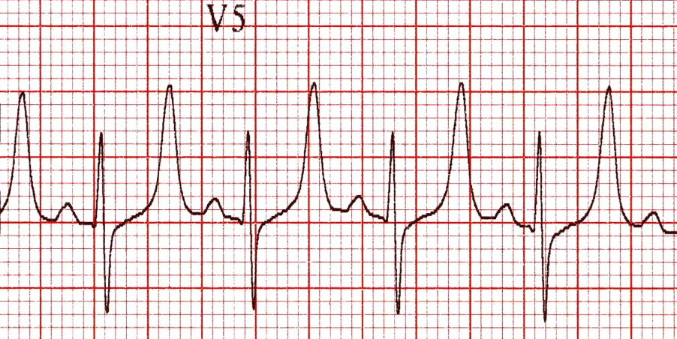
Diagnostics
Serial ionized calcium, magnesium, and potassium
Serial ECGs
hypocalemia, hypomagnesemia
hyperkalemia

Slide 42
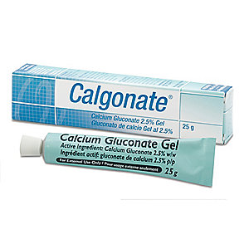
Managing Dermal Toxicity
First step always decontamination/irrigation with water or saline
First try topical calcium gluconate
  Binds fluoride ions and prevents systemic absorption
  25ml of 10% calcium gluconate in 75ml of lubricant
  Commercially available products
Notes:
Can place in a glove and put glove on for hand/finger exposures

Slide 43
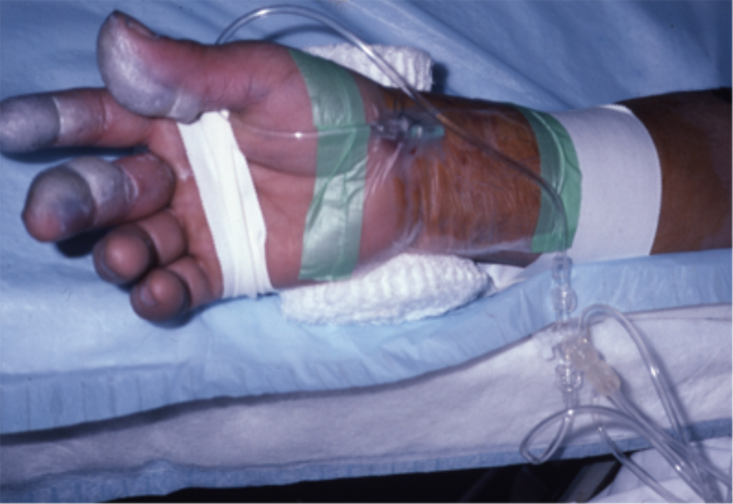
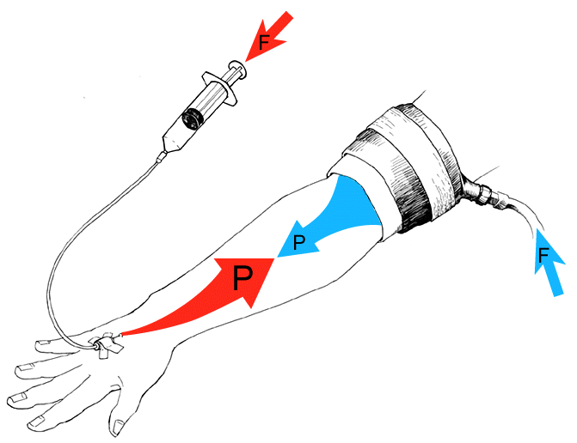
Managing Dermal Toxicity
If topical fails, other options:
  Intradermal: no more than 0.5ml/cm²
  Intraarterial: 50ml of 2% calcium gluconate over 4 hours through radial or brachial artery
  Intravenous Bier block with 25ml of 2.5% calcium gluconate
Notes:
Intradermal is difficult in tight spaces like the fingertips, fingernails, and hand

Slide 44
Inhalation
Management
Ingestion
Nebulized calcium gluconate
  4ml of 2.5-5% solution
  Give to all symptomatic HF inhalational exposures
Should attempt NG aspiration given almost universal mortality
Calcium or magnesium oral solution

Slide 45
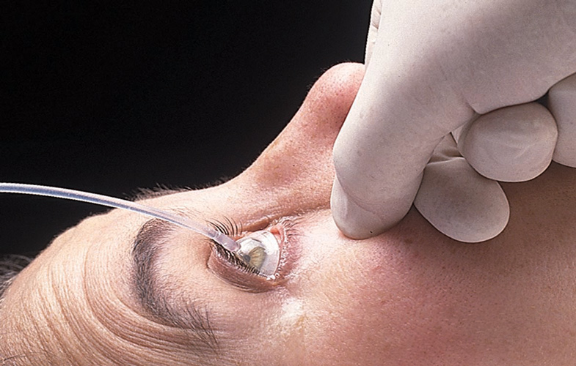
Ocular Toxicity
Irrigate with saline or water
Calcium gluconate can be quite irritating to eye
Best to consult ophthalmology prior to using calcium

Slide 46
Management of Systemic Toxicity
Local calcium and magnesium to limit absorption
Intravenous calcium and magnesium
Intravenous bicarbonate for severe acidosis
  NOTE: calcium and bicarbonate cannot mix in the same IV
Consider dialysis to augment fluoride ion elimination

Slide 47
Summary Slide

Slide 48
Questions…??

